Slide 1

Working with Chat Completions Part 4

Slide 2
Lech Walesa
“I use many different gadgets connected with computers; I use PCs, laptops and a Palm Pilot. I also use the Internet to visit websites, especially within Polish-language Internet. I usually go to political discussion groups and sites - of course, as I use my real name, people never believe that they are chatting with me!”

Slide 3




Notes:
https://www.youtube.com/channel/UC35ZpwldGw7ZJ5R-2sLijzw

Slide 4


Membership has its privileges
Notes:
https://www.youtube.com/channel/UC35ZpwldGw7ZJ5R-2sLijzw/join

Slide 5
What Are Our Options?
messages
model
frequency_penalty
logit_bias
logprobs
top_logprobs
max_tokens
n
presence_penalty
response_format
seed
stop
stream
temperature
top_p
tools
tool_choice
user
Notes:
https://platform.openai.com/docs/api-reference/chat/create

Slide 6
Getting Probabilities
The logprobs argument
Notes:
https://platform.openai.com/docs/api-reference/chat/create#chat-create-logprobs
https://cookbook.openai.com/examples/using_logprobs

Slide 7

Notes:
https://platform.openai.com/docs/api-reference/chat/create#chat-create-logprobs

Slide 8
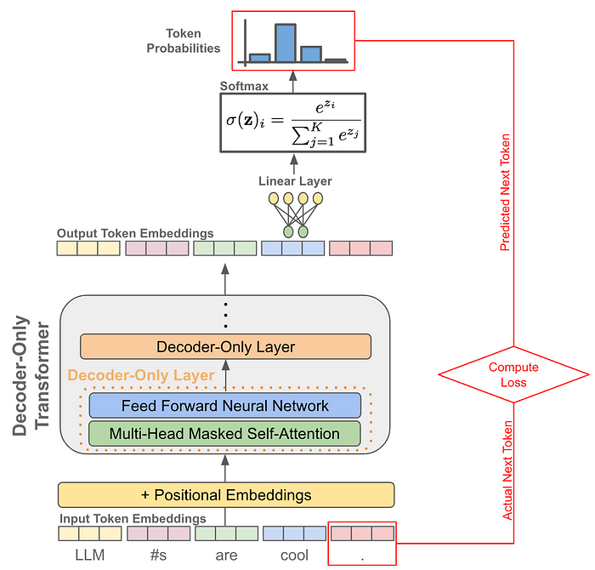
Prediction

Slide 9
Why Bother?
Avoiding Tiny Numbers: Using logarithms helps manage extremely small probabilities by transforming them into larger, more manageable numbers.
Easier Calculations: Logarithms turn multiplication of probabilities into addition, simplifying calculations.
Dealing with Zero: Logarithms convert a probability of zero into negative infinity, which can be handled specially to avoid issues in multiplication.
Improving Computer Learning: Using log probabilities helps in training models more smoothly and with fewer numerical issues.
Measuring Information: Logarithms are essential in measuring the amount of information or uncertainty in predictions.
Handling a Wide Range of Values: Logarithms allow for a broader, more reliable representation of varying magnitudes in probabilities.

Slide 10
Looking at the Top Probabilities
The top_probs argument
Notes:
https://platform.openai.com/docs/api-reference/chat/create#chat-create-top_logprobs

Slide 11
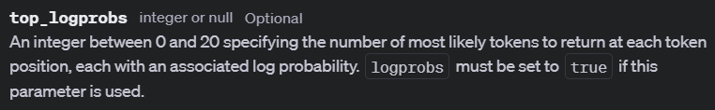
Notes:
https://platform.openai.com/docs/api-reference/chat/create#chat-create-top_logprobs

Slide 12
Why Use This?
Focus on the Most Likely Outcomes: Top logprobs help focus computational resources and analysis on the most likely outcomes, reducing the complexity and increasing the efficiency of the process.
Improve Decision-Making: By considering only the most probable options, models can make quicker and often more accurate decisions in real-time applications such as speech recognition or predictive typing.
Simplify the Output Space: In scenarios with a large number of possible outcomes, top logprobs simplify the problem space, making it easier to handle and visualize.
Enhance Interpretability: Analyzing the top logprobs makes it easier to understand what the model considers most likely, providing insights into its behavior and decision-making process.
Reduce Storage and Computational Costs: Storing and processing only the top probabilities instead of the entire distribution saves on memory and speeds up computations, which is crucial for deploying models on devices with limited resources.

Slide 13


